Slide 1
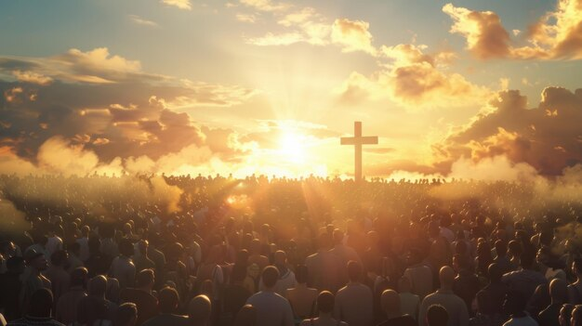
The Blood-Bought Church
Redeemed by the Blood of the Lamb
Acts 20:28  1 Peter 1:17-19
Notes:
Christians belong to Christ. The blood of the Lamb purchased every Christian and the church as a whole. Because Christians belong to Christ they live to glorify Him, and refuse to become servants of any other. Because the church belongs to Christ, He is its Head, and it will follow no other nor allow any other to direct its mission and work.
Image designed by Freepik – Freepik.com

Slide 2
Christians Belong to Christ
He has paid the redemption price for us (Revelation 5:9).
We are His (Romans 14:8; 1 Corinthians 3:23).
Christlikeness characterizes our lives.
  We are Christians (Acts 11:21-26; 26:28; 1 Peter 4:16).
  We are God-fearing (1 Peter 1:17-19; Hebrews 5:7).
  The flesh is crucified (Galatians 5:24).

Slide 3
Christians Belong to Christ
Because we are His…
  We live to glorify God (1 Corinthians 6:20).
  We refuse to become slaves of anyone or anything else (1 Corinthians 7:23; Romans 6:16; Matthew 6:24).
  We live purified lives devoted to good works (Titus 2:14; Acts 10:38).

Slide 4
The Church Belongs to Christ
The church is Christ’s body (1 Corinthians 12:12; Acts 2:47;11:26).
He purchased the church with His blood (Acts 20:28).
He built the church (Matthew 16:18).
He saved and sanctified the church (Ephesians 5:23-27; 4:4; Acts 2:41-47).
He is the head of the church (Ephesians 1:22-23; 3:10-11; Colossians 1:18-20).

